Slide 1


TITE SALES PERFORMANCE ANALYSIS
Ezeh Confidence Adaeze

Slide 2
Table of Content
Problem Statement
01
Process
02
Dashboard
03
INSIGHTS
04
RECOMMENDATIONS
06

Slide 3
PROBLEM STATEMENT
TITE is a growing retailer specializing in electronic gadgets and accessories. Recently, the company has been experiencing a trend where sales continue to grow steadily, yet profitability is declining. They seek to understand the underlying factors causing this discrepancy and to optimize their operations to improve profitability without compromising sales growth.
OBJECTIVES:
Sales Analysis
Understand overall sales trends.
Identify geographical variations in sales.
Analyze sales patterns by product category and subcategory.
Profit Review
Assess profitability across different product categories and segments.
Understand the impact of discounts on profitability.
Evaluate the effectiveness of different shipping modes on profitability.

Slide 4
PROBLEM STATEMENT (Cont.)
Customer Shopping Habits
Identify high-value and low-value customers.
Understand customer preferences across different segments.
Product Performance Check
Evaluate the profitability of different product categories and subcategories.
Identify products that contribute positively or negatively to overall profitability.
Tips to Improve
Recommend strategies to increase sales revenue.
Propose ways to optimize discount strategies.

Slide 5
PROCESS
Data Collection
Data Description
Data Cleaning
Data Modeling
Data Analysis
Insights
Recommendations

Slide 6
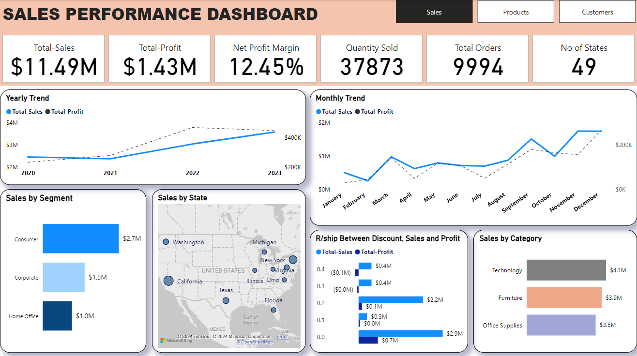
OVERVIEW

Slide 7
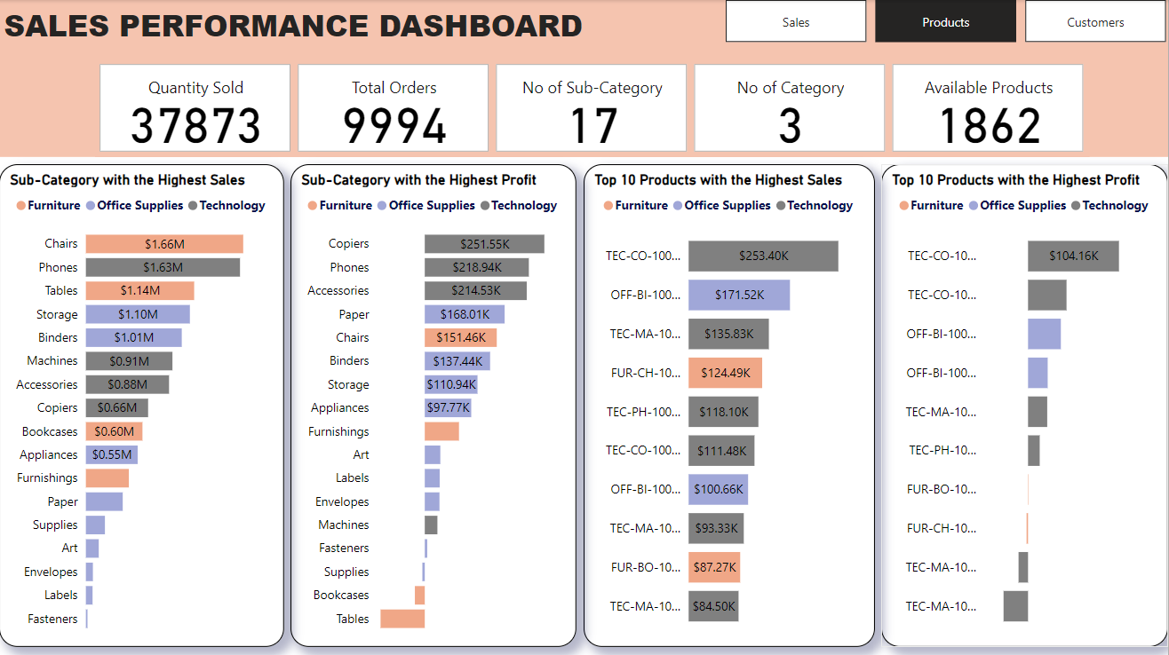
PRODUCTS

Slide 8
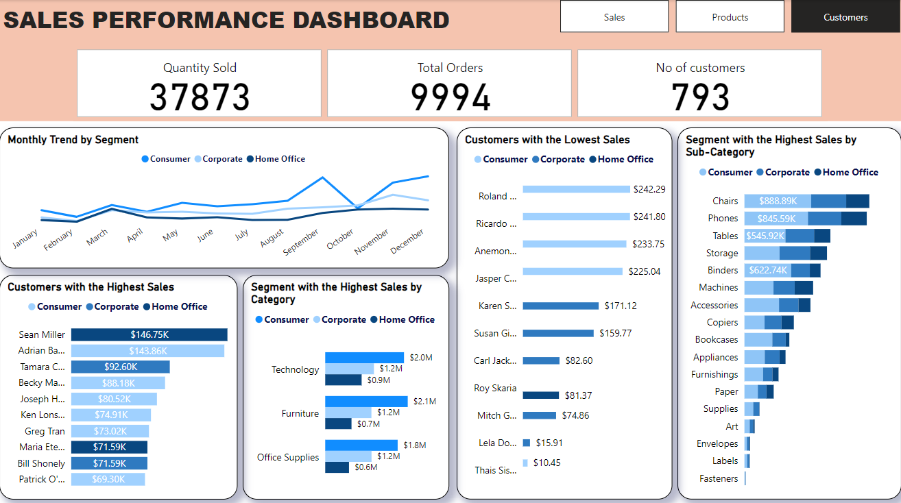
CUSTOMERS

Slide 9
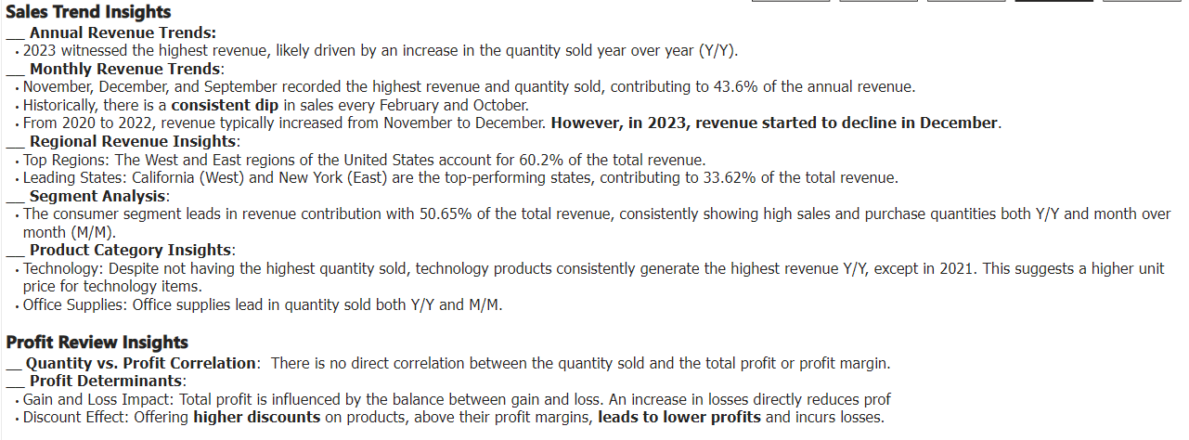
INSIGHTS

Slide 10
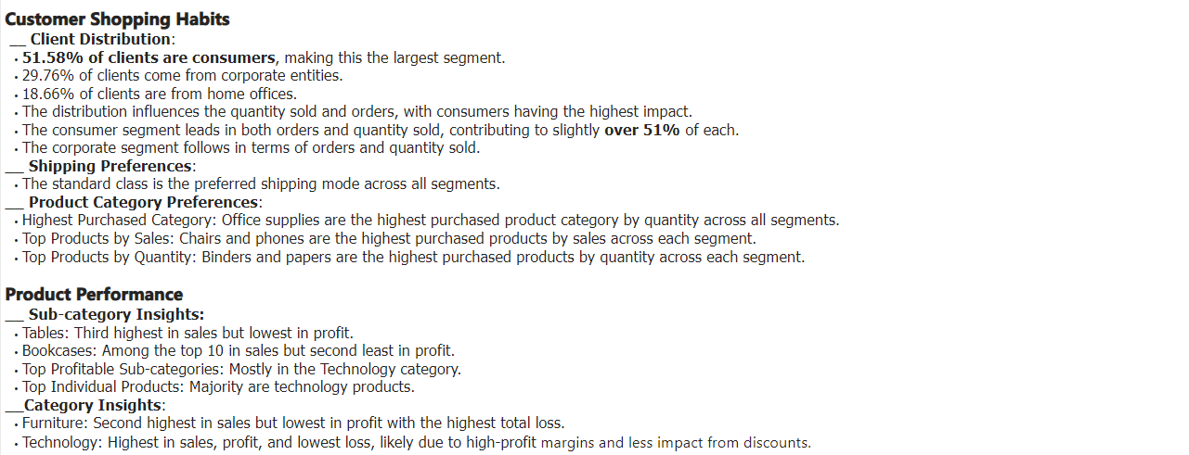
INSIGHTS

Slide 11
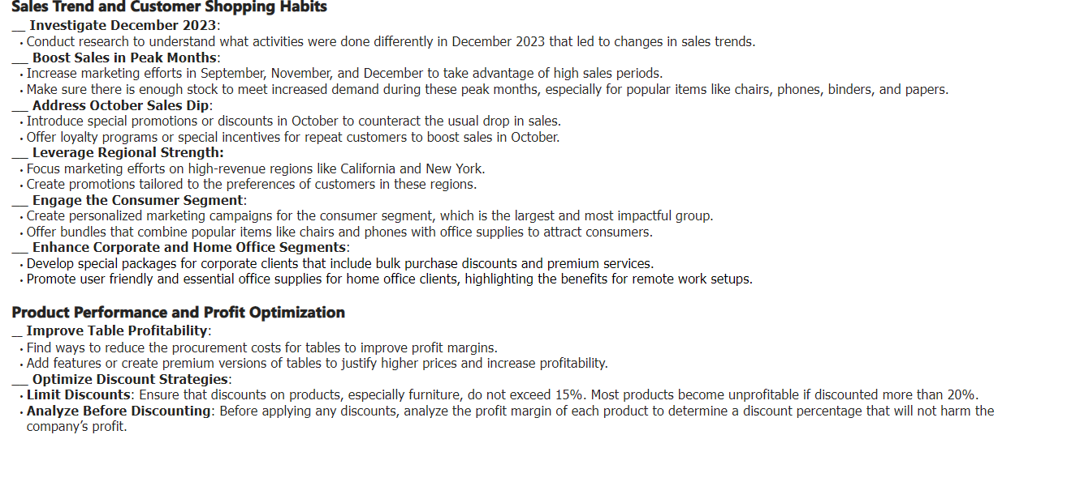
RECOMMENDATIONS

Slide 12
THANK YOU

